Slide 1

Psychometric Tools
The GC Index – Impact
MiRo - Personality

Slide 2

Helps interpret a persons innate energy to create impact within their organisation
Test for five ‘proclivities’
A business organi-metric NOT a personality profile
Doesn’t test for competence
Powerful tool in recruitment

Slide 3
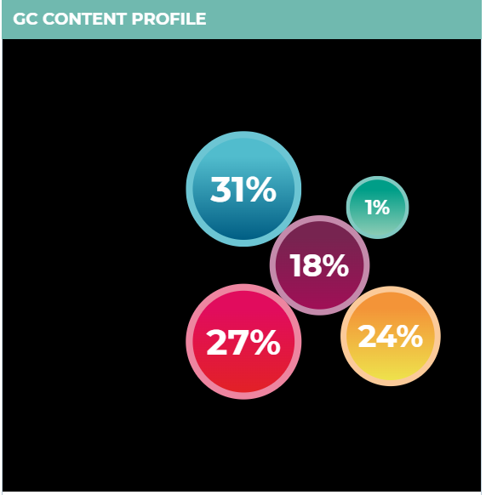
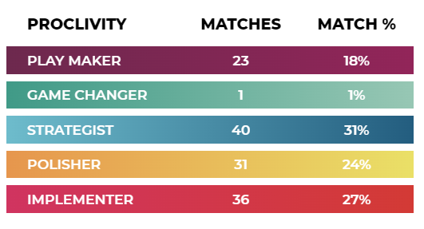
Job Description Analysis as Part of a Recruitment Process

Slide 4
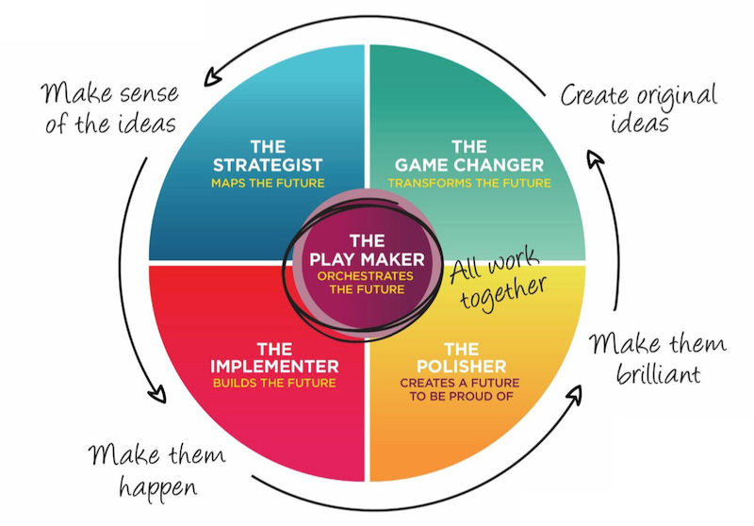
The GC Index Model

Slide 5

Traditional personality profiler
Jungian in origin – very similar to MBTi and Discovery Insights
Plots against four personality types as seen in the diagrams
Most useful in helping to ensure a good fit with the team
Is ‘good fit’ always a good thing?

Slide 6
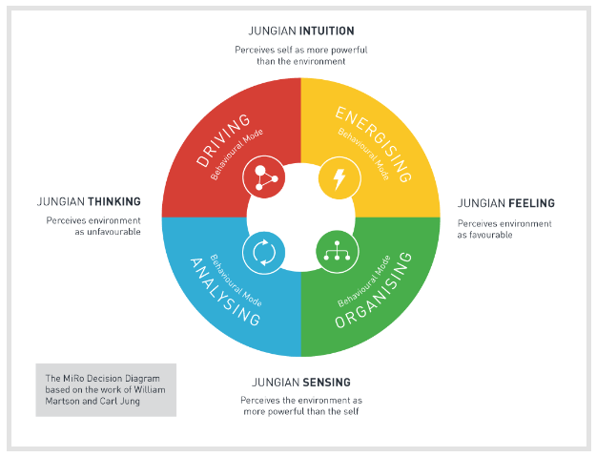
The MiRo Model
Here and now, concrete versus the intangible, the future
Introversion versus extroversion

Slide 7
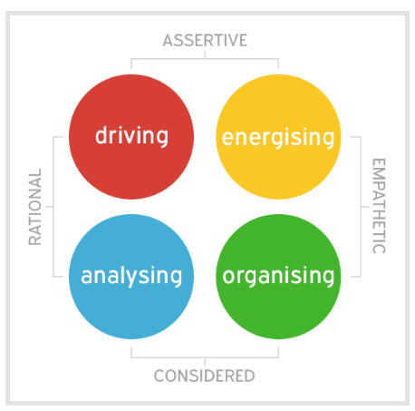
The Four Behavioural Modes
Drivers. Innovative, adventurous, rational and forceful
Energisers. Gregarious, creative and agreeable
Analysers. Detail orientated, rational and logical
Organisers. Stable, supportive and nurturing

